Slide 1

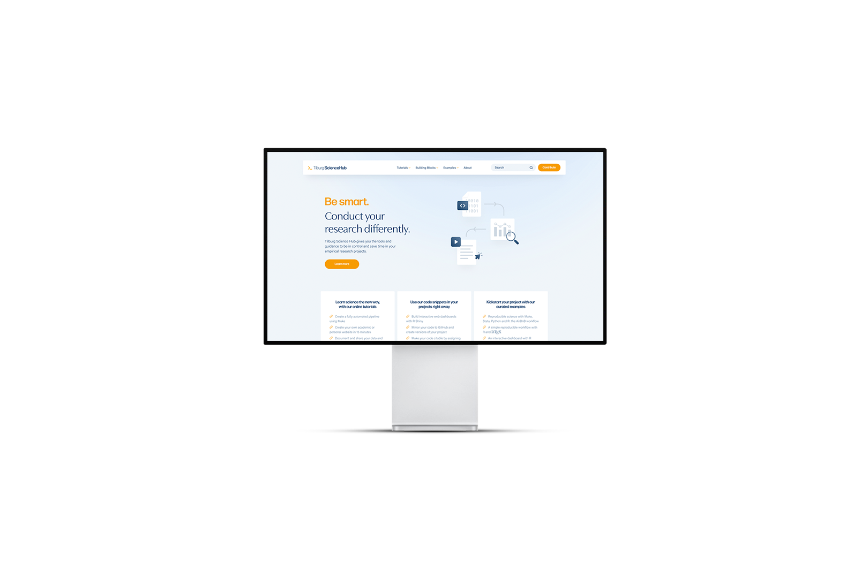
Tilburg Science Hub
An open-source platform supporting social-science researchers achieve Open, Sustainable and Reproducible Research
Start with your first tutorial at https://tilburgsciencehub.com
Follow us on LinkedIn (search for Tilburg Science Hub) or Twitter (@tilburgscience)

Slide 2

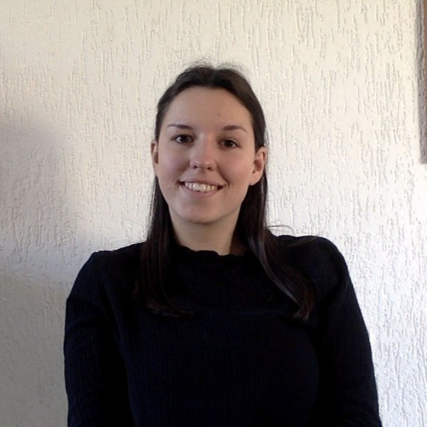

Hi there! - Meet the presenters
Fernando Iscar
MSc Data Science & Society
Fleur Le Mire
MSc Marketing Analytics
Diego Sánchez
MSc Data Science & Society

Slide 3
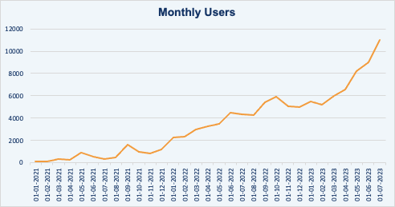
Tilburg Science Hub: an overview
>_ The Platform
Open-source digital platform
Promotes sustainable & reproducible research
Provide(s) resources to make open science accessible
Combines theory and practical guidance
>_ Core Content
Open science (e.g., reproducible research)
New tooling (e.g., GitHub, workflows)
New skills (e.g., big team science, Scrum)
>_ Impact
Total visits: 113.000 users (between Jan ’21 – today)
Monthly visits: over 12k per month (August ‘23)

Slide 4
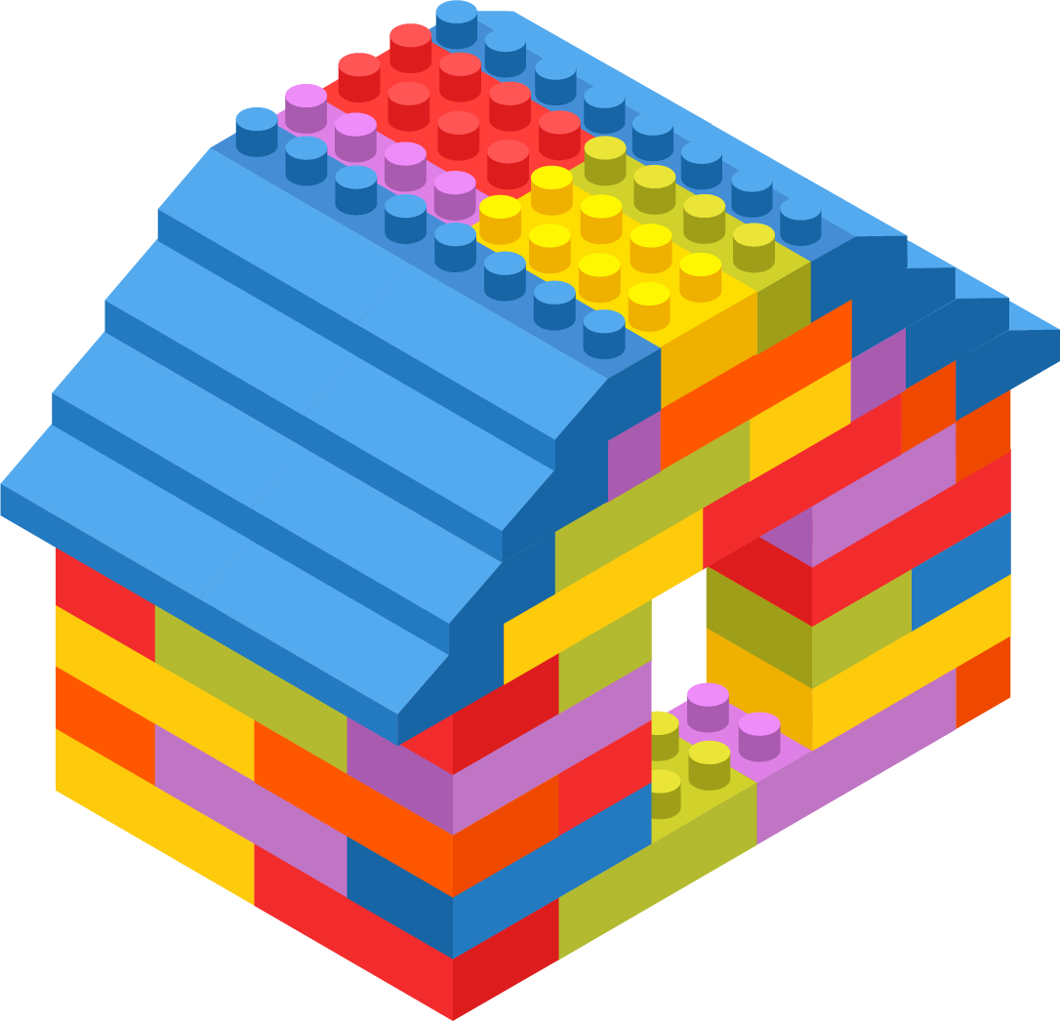
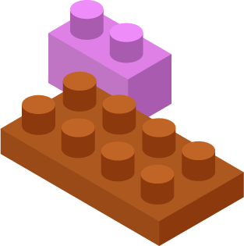
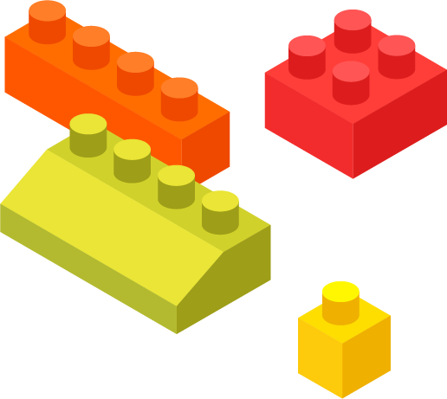
What does Tilburg Science Hub offer?
>_ Building Blocks: Practical code snippets and explanations (+100 already available!)
>_ Tutorials: Step-by-step guidance on broader topics
>_ Examples: Real-life cases showcasing open science application
Notes:
Tilburg Science Hub is guided by core values driving our mission:
To empower researchers and students to collaborate seamlessly on empirical research projects. We promote an agile research culture, emphasizing teamwork, feedback exchange, and active collaboration. TSH encourages reaching out to colleagues, sharing insights, and using GitHub for seamless cooperation. Moreover, We learn new things every day. Sharing new tools and code snippets is highly encouraged.
TSH offers its wealth of knowledge through three distinct formats:
· Building Blocks explain theories and provide practical code snippets for various programming languages and operating systems. They cater to both novice and advanced users, facilitating concept implementation within ongoing projects.
· Tutorials guide users through broader topics step by step, aiding them in combining Building Blocks to create complete projects. Tutorials are particularly beneficial for newcomers.
· Examples where real-life cases, templates, publications, and research projects illustrate platform concepts, showcasing practical applications of open science principles.
Whether you're an experienced researcher, a curious student, or an innovative thinker, Tilburg Science Hub has something for you.
We invite you to take a tour of the platform and explore its resources. However, we also wanted to present to you a real implementation example for which Diego and Fernando have been recently working and which we believe illustrates the resources that Tilburg Science Hub aims at providing.

Slide 5

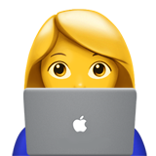

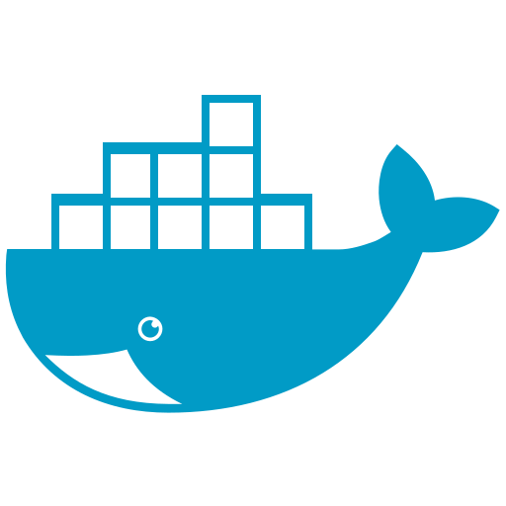





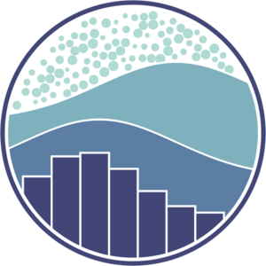


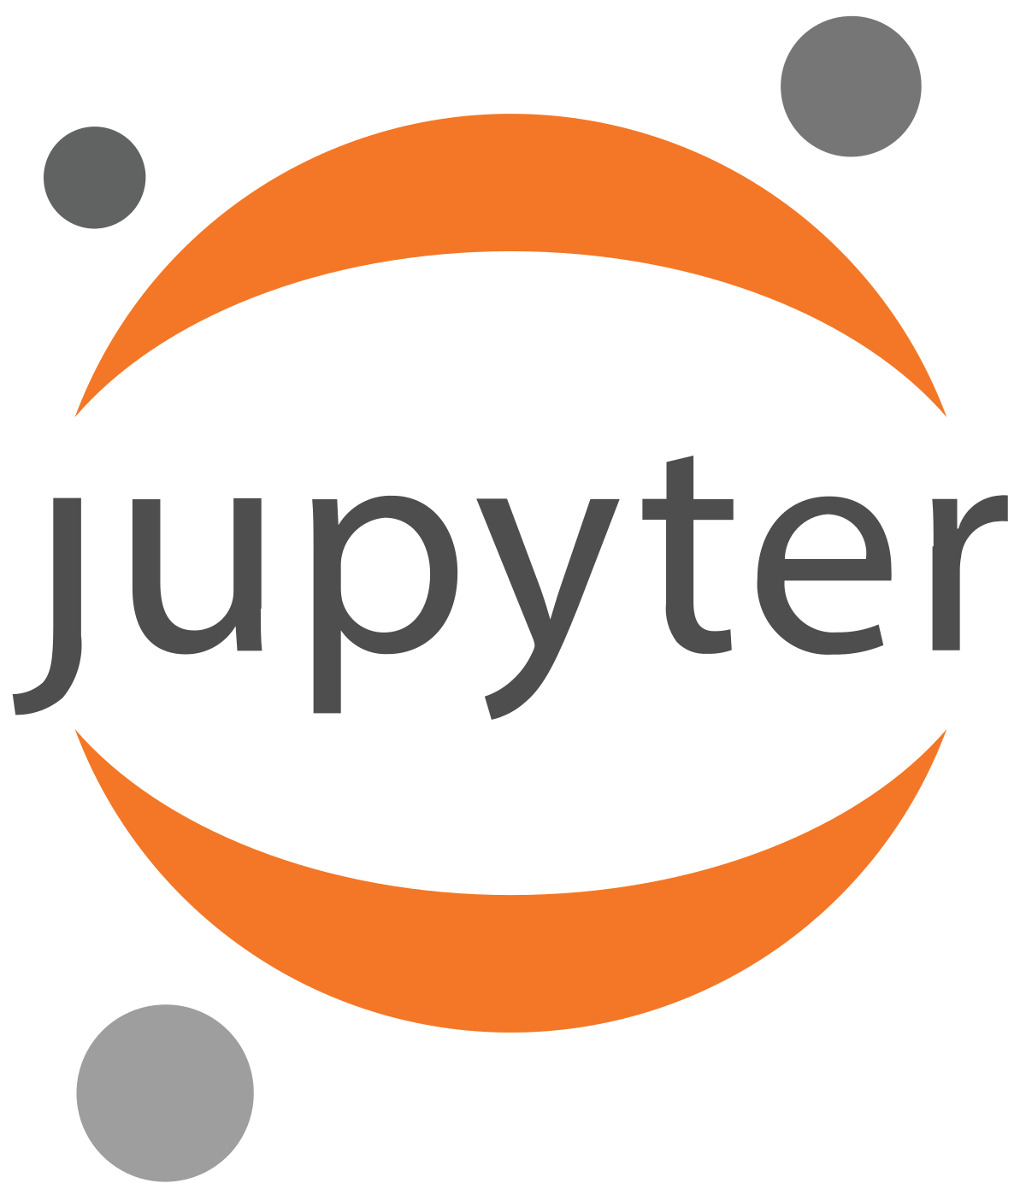
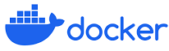

We care about Reproducibility:
Introducing Docker
>_ Containerization: more than code & libraries
>_ Isolation: ensured reproducibility
>_ Consistent: If it works on my machine it works
>_ Easy to share and deploy
>_ Scalability: your project has room to adapt grow
on yours

Slide 6
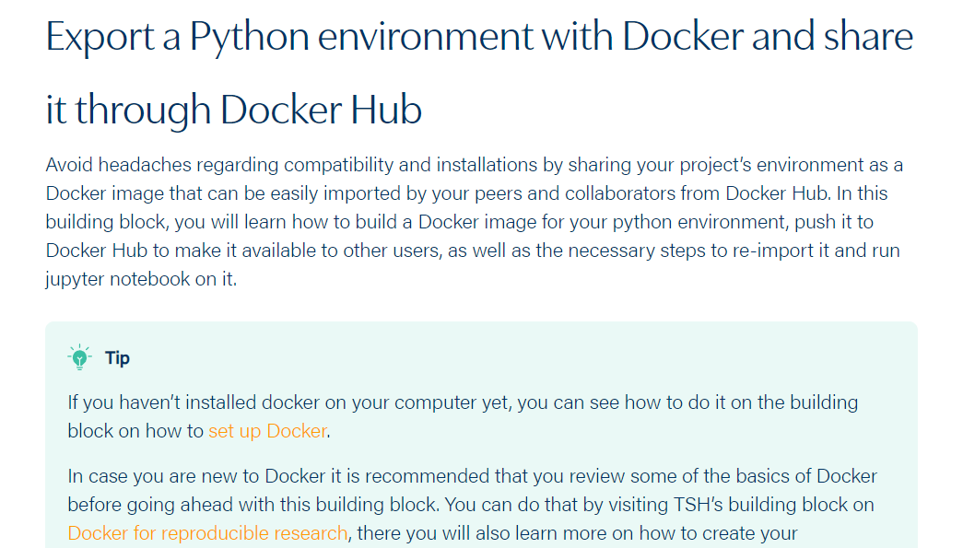
We care about Reproducibility:
Introducing Docker
>_ Containerization: more than code & libraries
>_ Isolation: ensured reproducibility
>_ Consistent: If it works on my machine it works
>_ Easy to share and deploy
>_ Scalability: your project has room to adapt grow
on yours

Slide 7
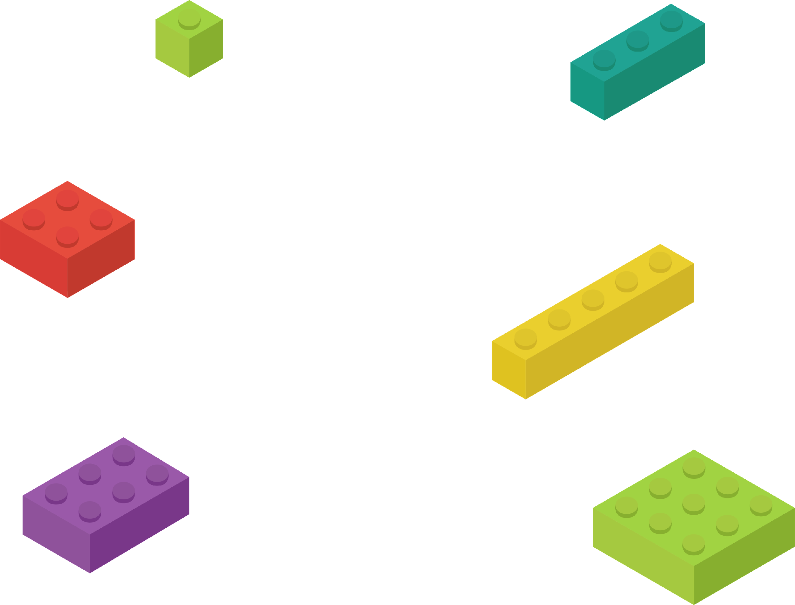
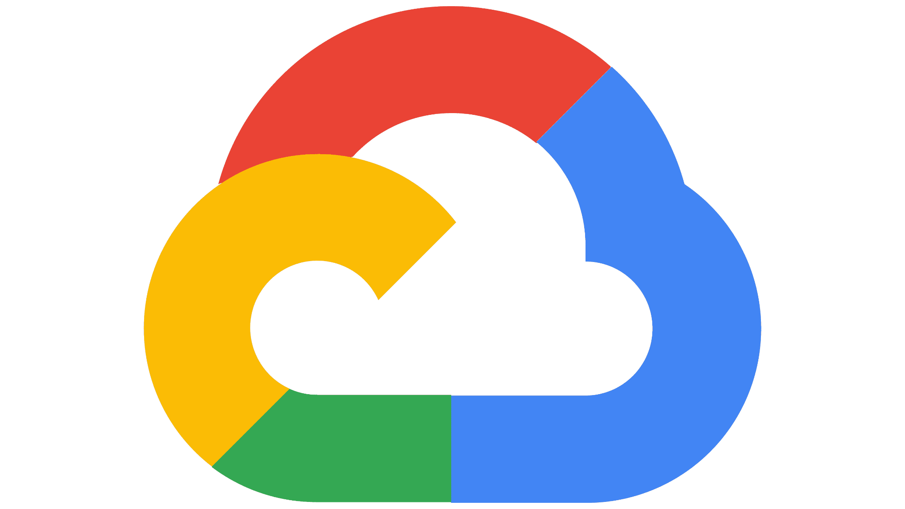
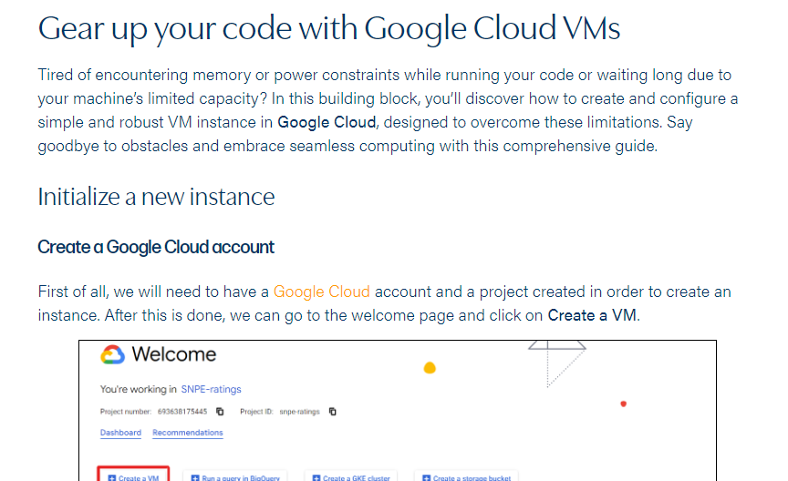
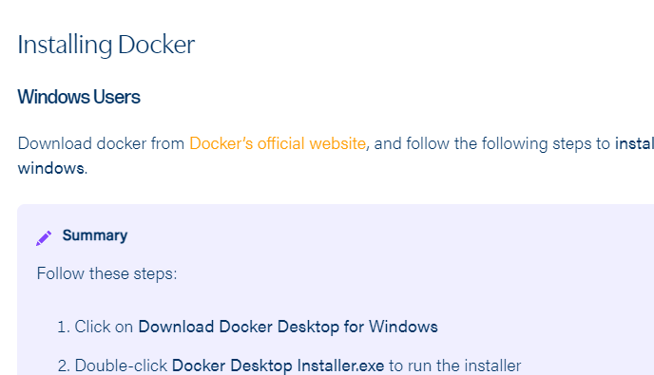
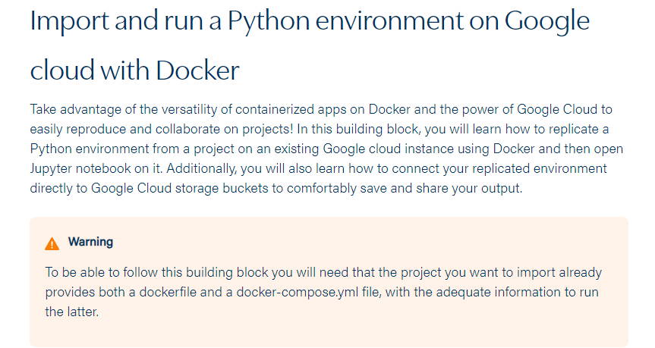



Tools to Ensure Reproducibility and more
>_ Docker and Cloud compatibility
>_ How to…
Install & set up software
Document your project
Use Git/GitHub
…
…And muchmore!

Slide 8
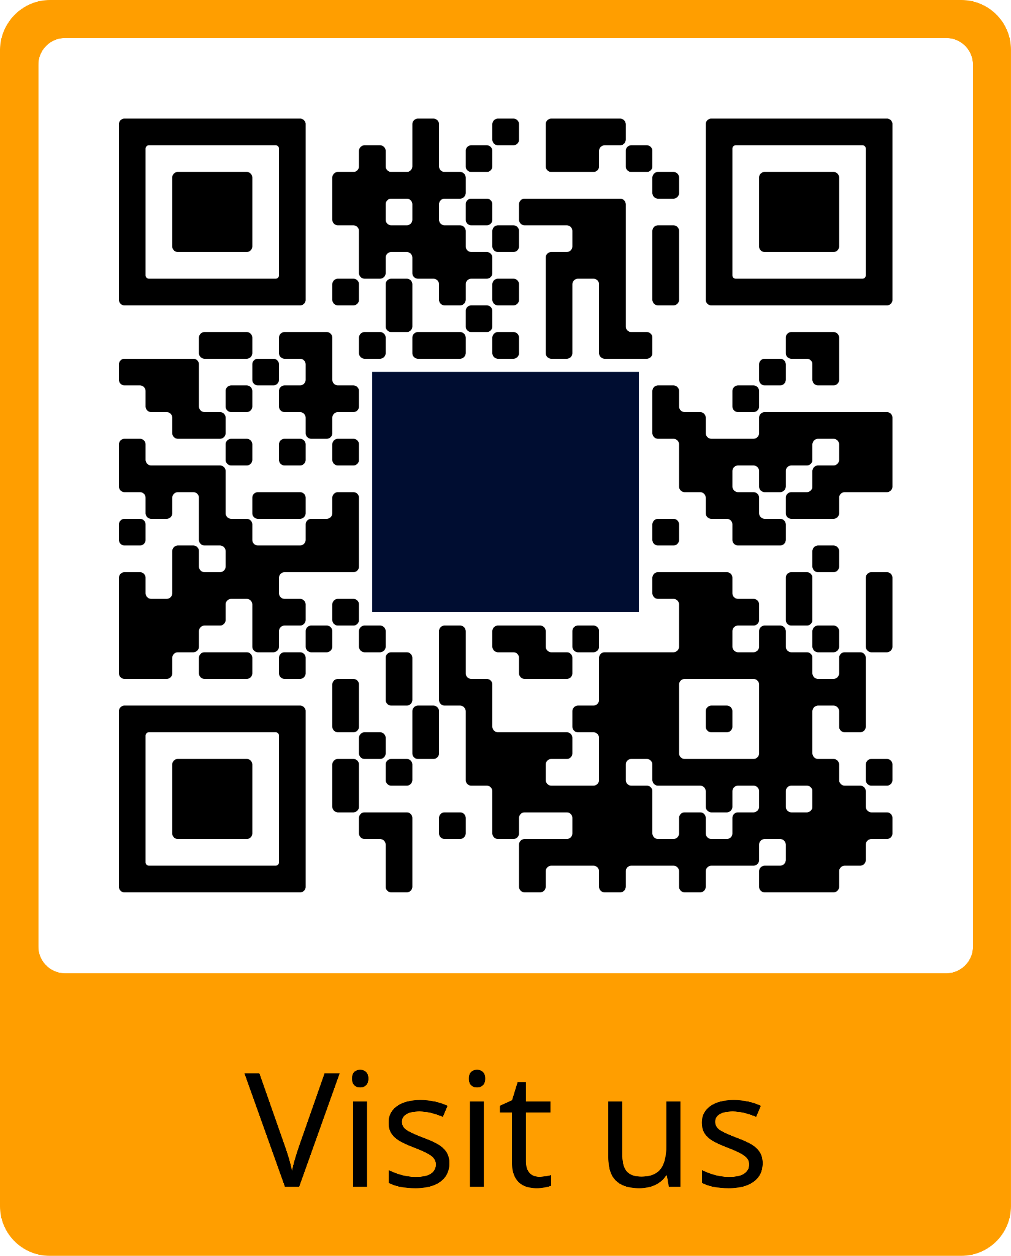
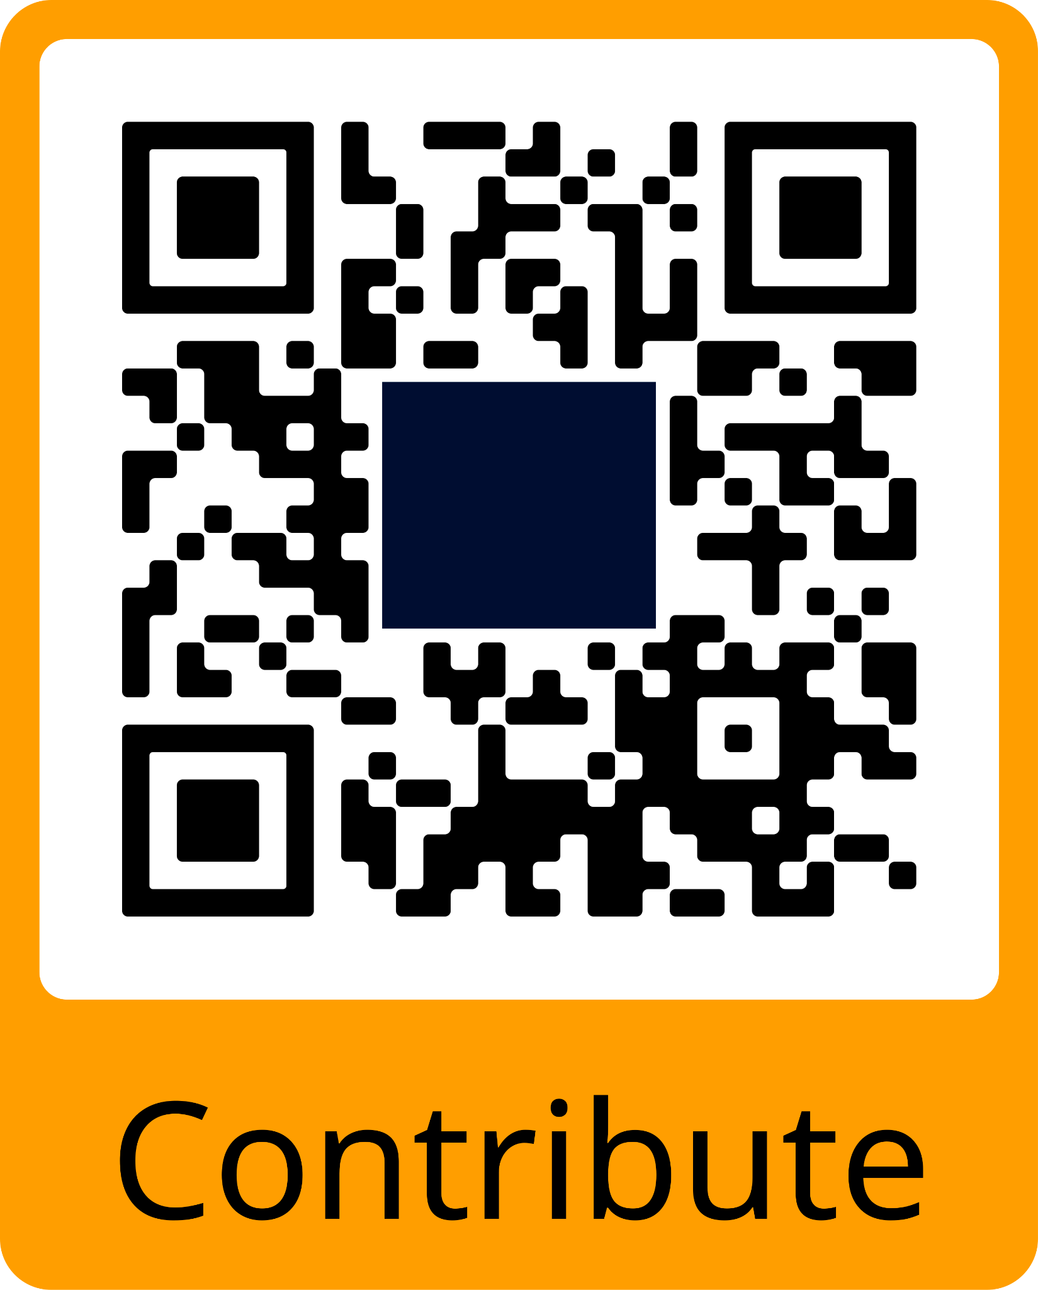
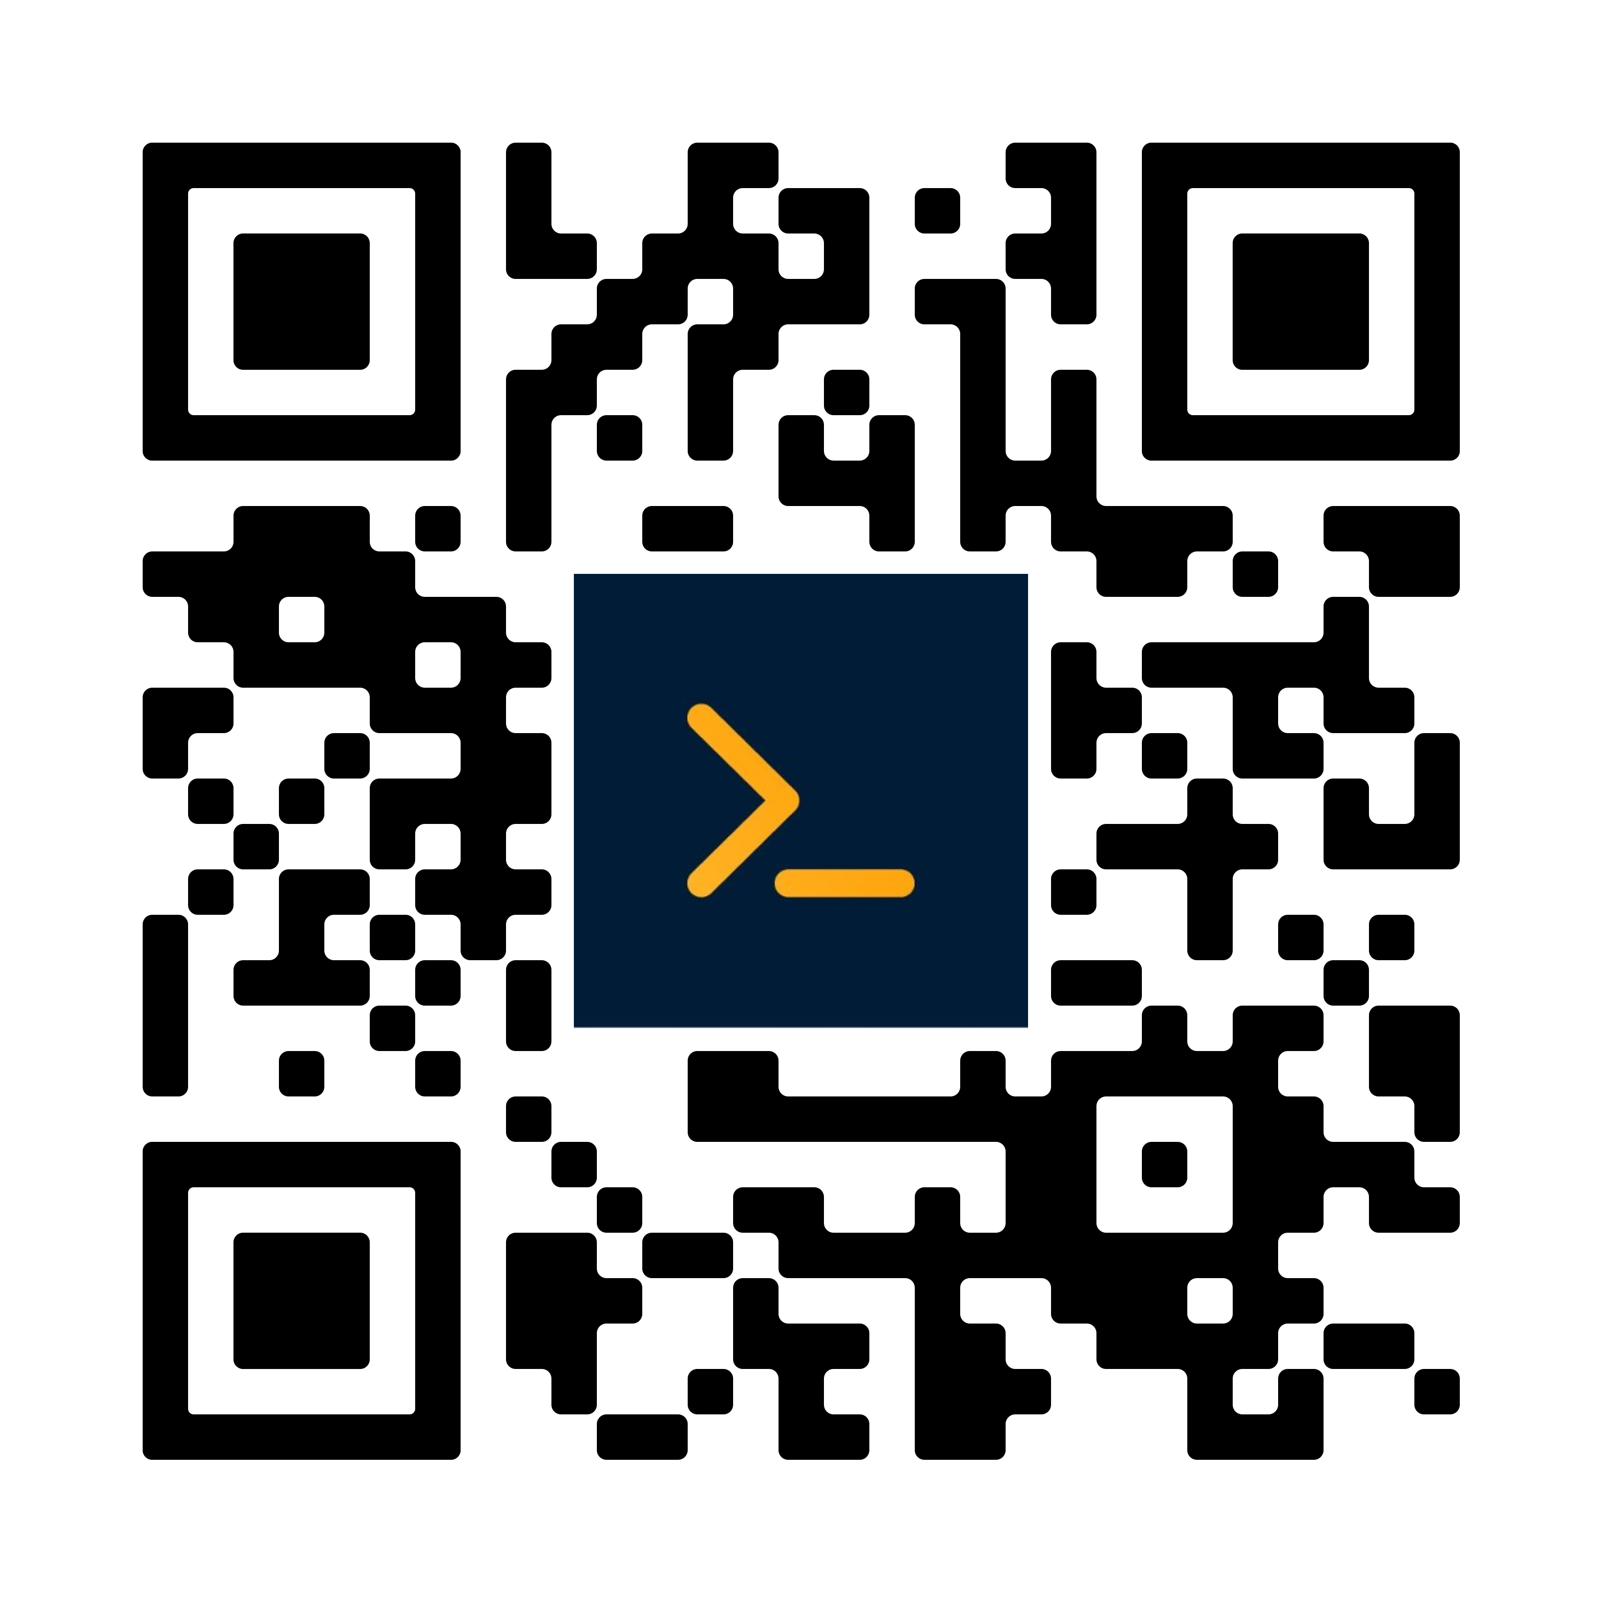
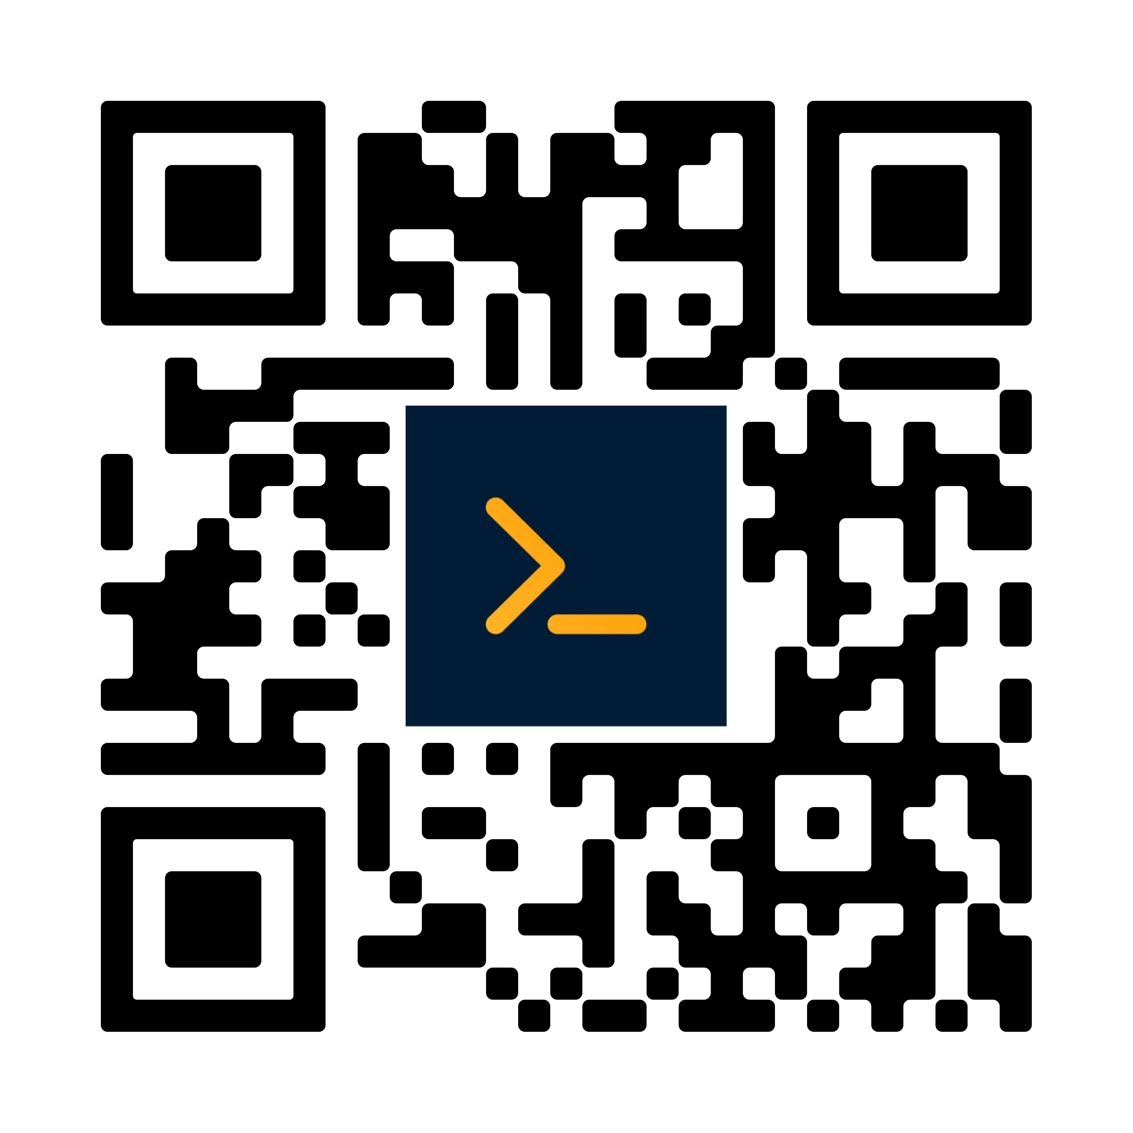

Get to know our platform!
Visit us!
Contribute!

